Slide 1
Bot Fly
By Cassidy Ranes

Slide 2
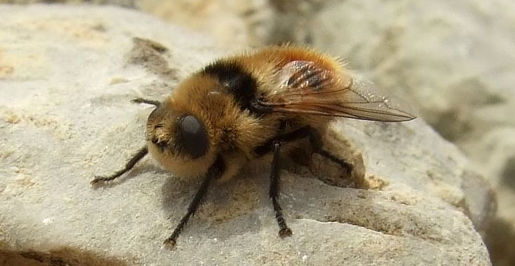
Bot flys are parasites that bother horses. Although they are a fly, they are an internal parasite. So how do flys bother the inside of a horse?

Slide 3
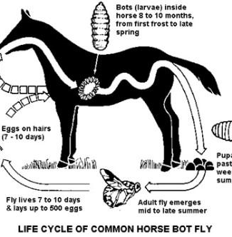
Bot fly life cycle
Bot flys undergo a complete metamorphosis.
The life cycle isnt restricted to a certain season, but generally eggs are laid in the early summer

Slide 4
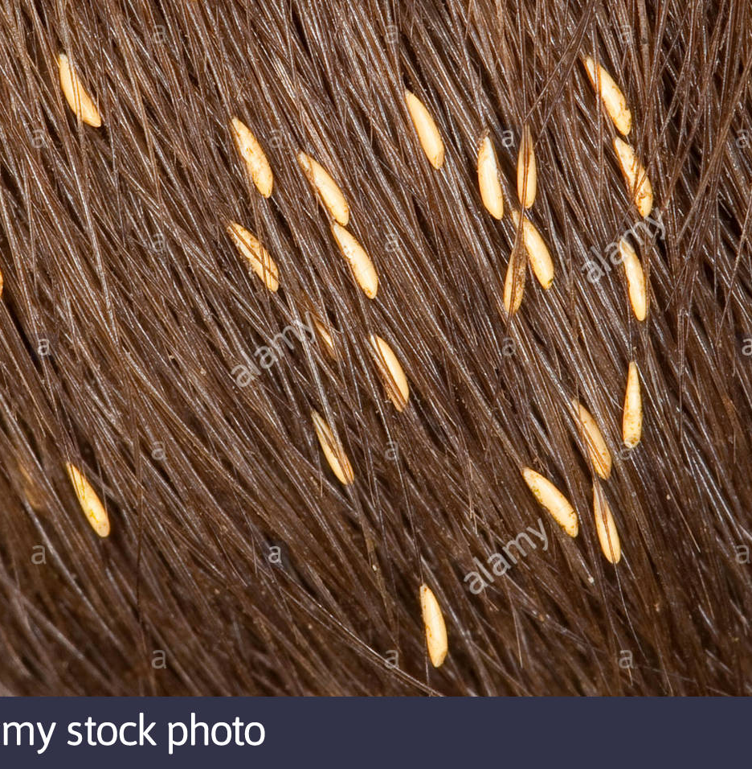
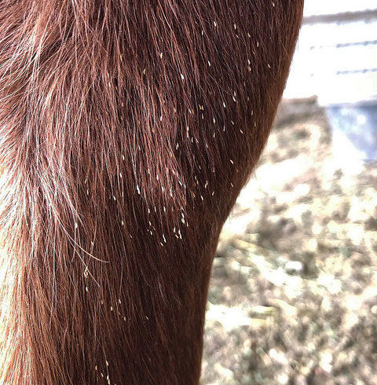
Bot Fly Eggs …A female bot fly can lay 150 to 1000 eggs on a horses leg they lay them on the leg so the horse will eat them and then hach in there body and then the horse will produce wast and thats when they come out.

Slide 5
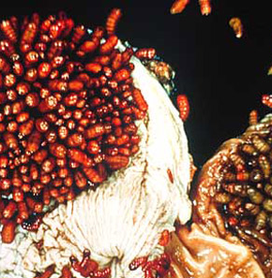
Bot Fly Larvae
Bot fly larvae are nothing to laugh at they hatch in the stomach. And then the larvae will be ready to be a fly and journey out of the horses body.

Slide 6
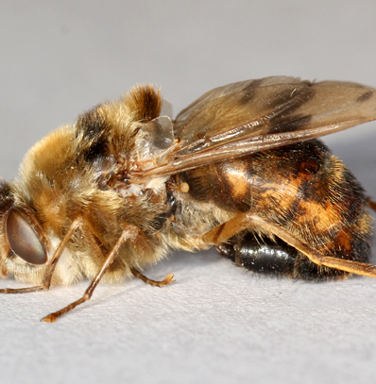
Bot Fly Adult
When the bot fly’s are more mature they will quickly find mates and will have more fly's.

Slide 7
Were do bot fly’s live?
Bot fly’s live in most warm places. Not in California places like that its to dry here so they will live in Florida they like how moist it is.

Slide 8
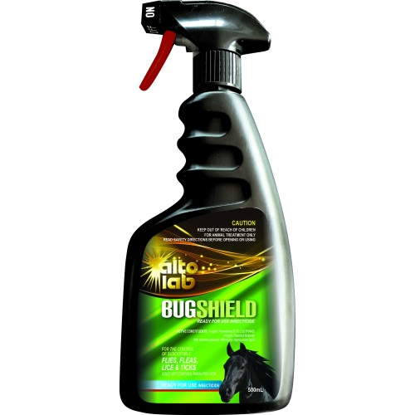
Prevention
How do we repeal bot fly’s? We can use this repellant tube so our horses wont get and bot fly's.

Slide 9
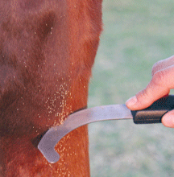
Treatment
How do we treat a horse with bot flys? We use a bot fly knighf to scrape off the bot fly eggs.

